Slide 1


ConsisRec: Enhancing GNN for Social Recommendation via Consistent Neighbor Aggregation SIGIR’21 , Virtual Event
Liangwei Yang, Zhiwei Liu, Yingtong Dou (University of Illinois at Chicago)
Jing Ma (Sichuan University)
Philip S. Yu (University of Illinois at Chicago)
Code: https://github.com/YangLiangwei/ConsisRec.git

Slide 2
Background

Slide 3






Social Recommendation
Assumption:
Homophily^{[1]}:
People tend to be connected if they are more similar to each other.
Social influence character^{[2]}:
People would influence its connections from his or her own preference.
Rating=5
Rating=4
Friend
Rating=?
Rating=1
Friend
Rating=4
[1] McPherson, M., Smith-Lovin, L., & Cook, J. M. (2001). Birds of a feather: Homophily in social networks. Annual review of sociology, 27(1), 415-444.
[2] Marsden, P. V., & Friedkin, N. E. (1993). Network studies of social influence. Sociological Methods & Research, 22(1), 127-151.

Slide 4

Graph Neural Network (GNN)
General GNN structure
AGG: Aggregator of neighbor information, such as max pooling, weighted average
: Combination of neighbor information and center node information, such as linear layer, addition
GNN based social recommendation
GraphRec^{[1]}: Use GNN to aggregate information, and several linear layers to predict rating.
DANSER^{[2]} : Use GAT to capture multi-faced social effect in recommendation.
GCMC^{[3]}: Initialize node feature with social embedding to include social information.
[1] Fan, W., Ma, Y., Li, Q., He, Y., Zhao, E., Tang, J., & Yin, D. (2019, May). Graph neural networks for social recommendation. In The World Wide Web Conference (pp. 417-426).
[2] Wu, Q., Zhang, H., Gao, X., He, P., Weng, P., Gao, H., & Chen, G. (2019, May). Dual graph attention networks for deep latent representation of multifaceted social effects in recommender systems. In The World Wide Web Conference (pp. 2091-2102).
[3] Berg, R. V. D., Kipf, T. N., & Welling, M. (2017). Graph convolutional matrix completion. arXiv preprint arXiv:1706.02263.

Slide 5
Motivation

Slide 6
Motivation
Assumption of GNN: neighbors share similar features, context, and labels (smoothness^{[1]})
This assumption is no longer hold in social recommendation, i.e., inconsistency problem
[1] Hou, Yifan, et al. "Measuring and improving the use of graph information in graph neural networks." International Conference on Learning Representations. 2019.

Slide 7
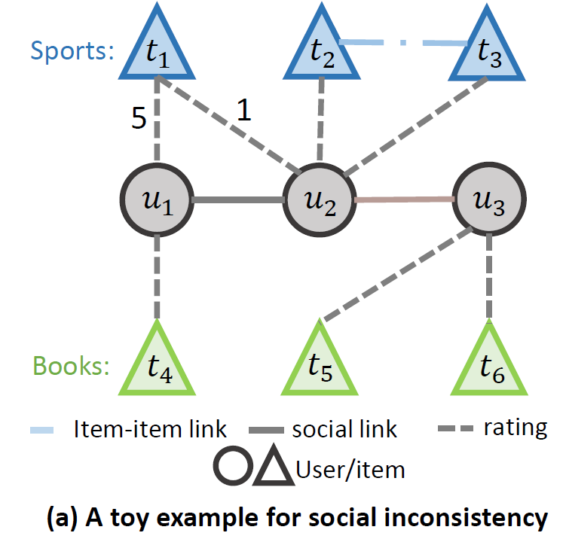
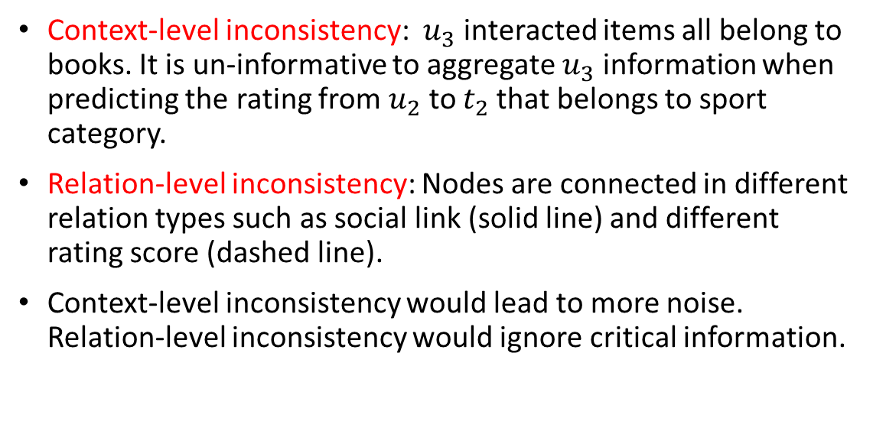
Motivation
Context-level inconsistency: $u_{3}$interacted items all belong to books. It is un-informative to aggregate $u_{3}$ information when predicting the rating from $u_{2}$ to $t_{2}$that belongs to sport category.
Relation-level inconsistency: Nodes are connected in different relation types such as social link (solid line) and different rating score (dashed line).
Context-level inconsistency would lead to more noise. Relation-level inconsistency would ignore critical information.

Slide 8
Proposed Model (ConsisRec)

Slide 9
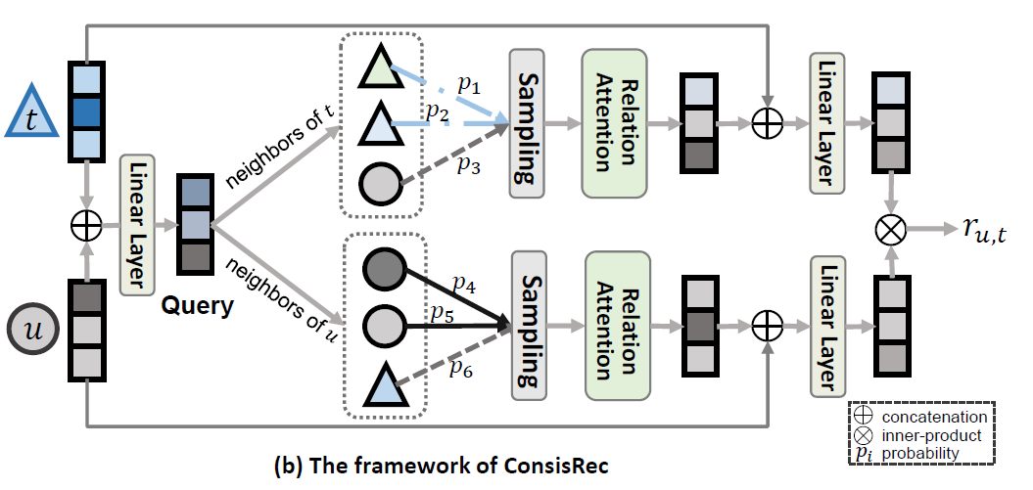
ConsisRec
Query layer: fuse user and item information of current rating procedure.
Neighbor sampling: sample informative neighbors based on consistency score.
Relation Attention: Use relation embedding to deal with various relations

Slide 10



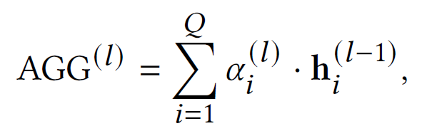
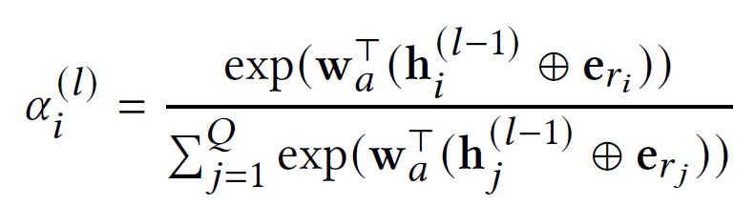

ConsisRec
Query layer
Neighbor sampling
Consistency score:
Relation attention
$Q$ : number of samples; $a_{i}^{l}$ :a scalar denoting the attention weights of i-th sample
$e_{r_{i}}$: the relation embedding of relation i.

Slide 11
Experiment

Slide 12
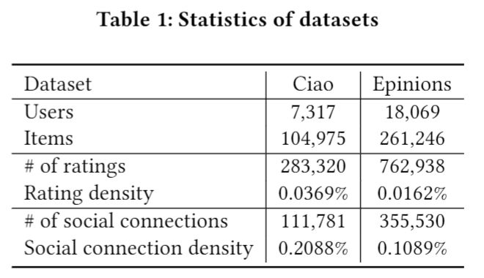
Experiment setting
Dataset
Remove users without social neighbors
Add item-item similarity link if they share more than 50% neighbors
60% used for training, 20% used for validation and 20% for test.
Baselines
Matrix factorization based: SoRec[1], SoReg[2], SocialMF[3], CUNE[4]
Graph neural network based: GCMC[5], GraphRec[6]
[1] Ma, H., Yang, H., Lyu, M. R., & King, I. (2008, October). Sorec: social recommendation using probabilistic matrix factorization. In Proceedings of the 17th ACM conference on Information and knowledge management (pp. 931-940).
[2] Ma, H., Zhou, D., Liu, C., Lyu, M. R., & King, I. (2011, February). Recommender systems with social regularization. In Proceedings of the fourth ACM international conference on Web search and data mining (pp. 287-296).
[3] Jamali, M., & Ester, M. (2010, September). A matrix factorization technique with trust propagation for recommendation in social networks. In Proceedings of the fourth ACM conference on Recommender systems (pp. 135-142).
[4] Zhang, C., Yu, L., Wang, Y., Shah, C., Zhang, X. (2017) Collaborative user network embedding for social recommender systems. In The SDM Conference
[5] Berg, R. V. D., Kipf, T. N., & Welling, M. (2017). Graph convolutional matrix completion. arXiv preprint arXiv:1706.02263.
[6] Fan, W., Ma, Y., Li, Q., He, Y., Zhao, E., Tang, J., & Yin, D. (2019, May). Graph neural networks for social recommendation. In The World Wide Web Conference (pp. 417-426).

Slide 13
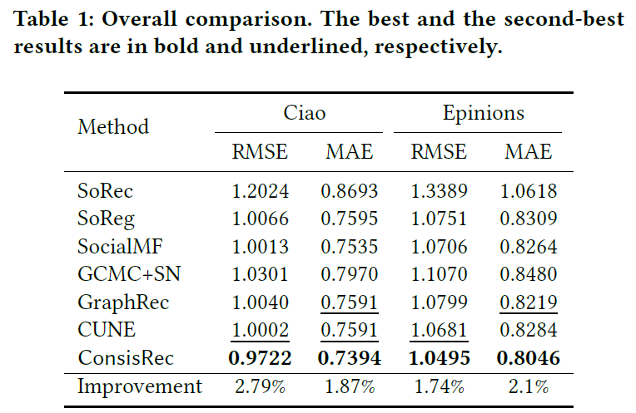
Overall Comparison
Observations
GNN based methods tend to be better than matrix factorization based methods.
ConsisRec performs the best among all the methods.
Improvement on RMSE and MAE criterion is very limited among methods.

Slide 14
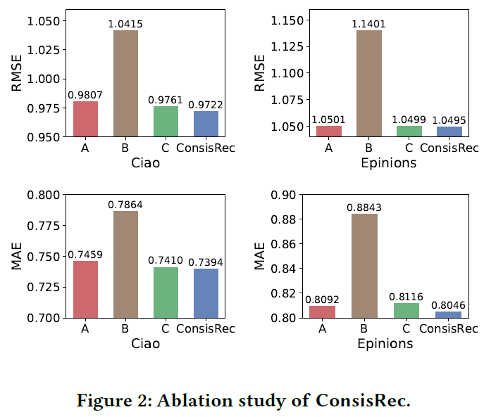
Ablation Study
Observations
ConsisRec always performs the best, indicting all the components are useful.
Remove neighbor sampling dramatically spoils the performance, which shows the importance of selecting consistent neighbors.
A: Remove query layer
B: Remove neighbor sampling
C: Remove relation attention

Slide 15
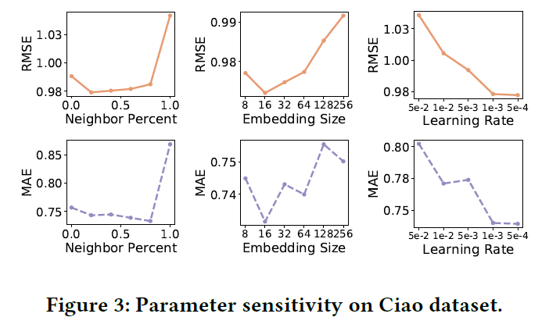
Parameter Sensitivity
Observations
There is an obvious error increment when neighbor percent rising from 0.8 to 1.0, which results from aggregating inconsistent neighbors.
Suitable embedding size should be selected.
Learning rate has a critical impact on model performance.

Slide 16
Discussion

Slide 17
Conclusion and Future Work
Conclusion
Study the inconsistency problems (Context/Relation) in social recommendation
Design three mechanisms in ConsisRec
Future work
Inconsistencies in other field.
Find more consistent neighbors?
Other way to measure consistency score?

Slide 18
Thanks!

